Slide 1





THEORY
Training Program 01
Advanced NLP & Large Language Models (LLMs)

Slide 2
THEORY
Training Program 01
M01: Text Preprocessing
M02: Word and Sentence Embeddings
M03: Transformer Architectures
M04: Entity-Centric NLP
M05: Applied NLP Tasks
M06: Multimodal NLP
M07: LLM Fundamentals
M08: Prompt Engineering
M09: Fine-Tuning & PEFT
M10: RAG & Real-World Projects

Slide 3
MODULE M01
TEXT PREPROCESSING
CHAPTER M08
Prompt Engineering

Slide 4
THEORY
Training Program 01
8.1 Introduction to Prompt Engineering: Why It Matters
8.2 In-Context Learning: Zero-Shot and Few-Shot
8.3 Chain-of-Thought: Eliciting Reasoning and Planning
8.4 Structured Prompting: RISEN and CARE Frameworks
8.5 Summary and Advanced Prompt Strategies

Slide 5
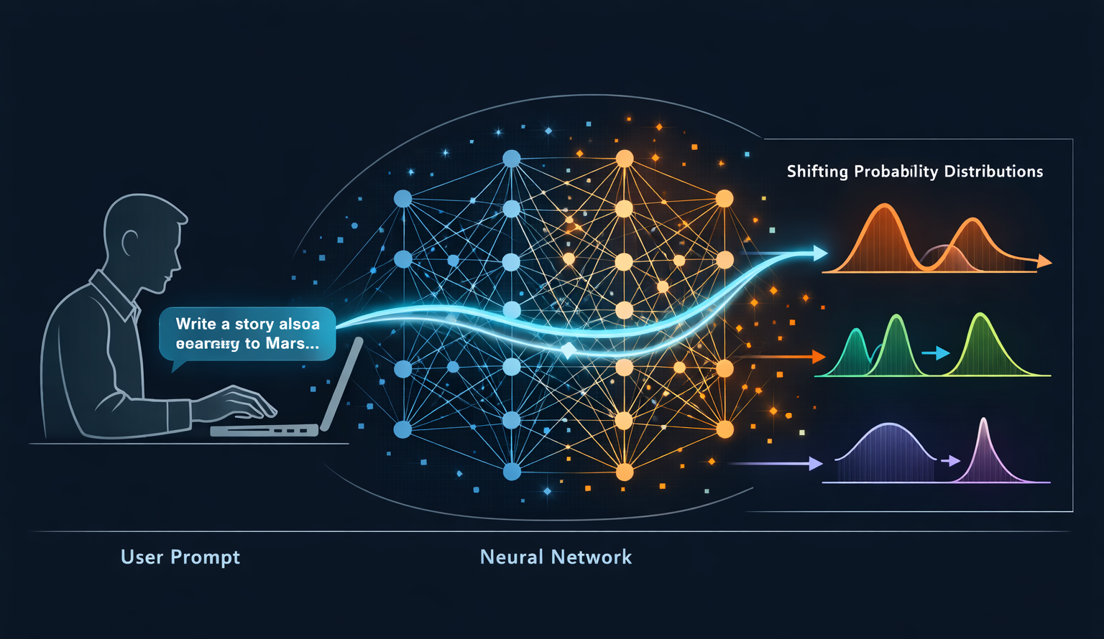
M08
Chapter 8.1 Introduction to Prompt Engineering: Why It Matters
What Is Prompt Engineering?
Prompt Engineering is the primary interface between human intent and large language models. It transforms natural language into a precise control mechanism for probabilistic systems.
LLMs are controlled through language, not code
Prompts shape the model’s internal probability distribution
Small wording changes can produce radically different outputs
Prompting is not chatting, it is system control

Slide 6
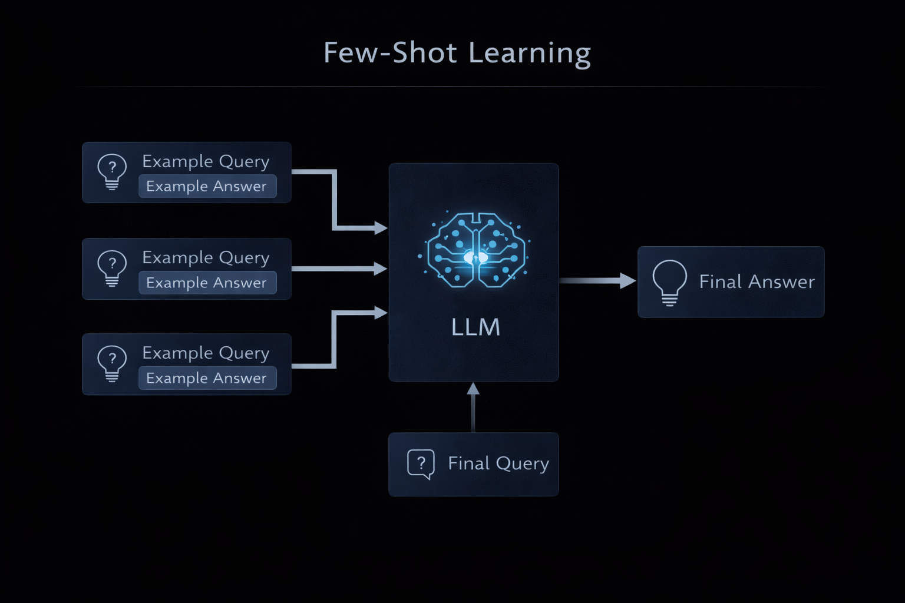
M08
Chapter 8.1 Introduction to Prompt Engineering: Why It Matters
Core Components of a Professional Prompt
Prompt Engineering replaces hard-coded logic with declarative language instructions. Instead of writing rules, developers describe outcomes.
Prompts function as a new programming layer.
Logic is expressed in natural language.
Focus on what to achieve, not how.
Enables rapid prototyping without training models.

Slide 7
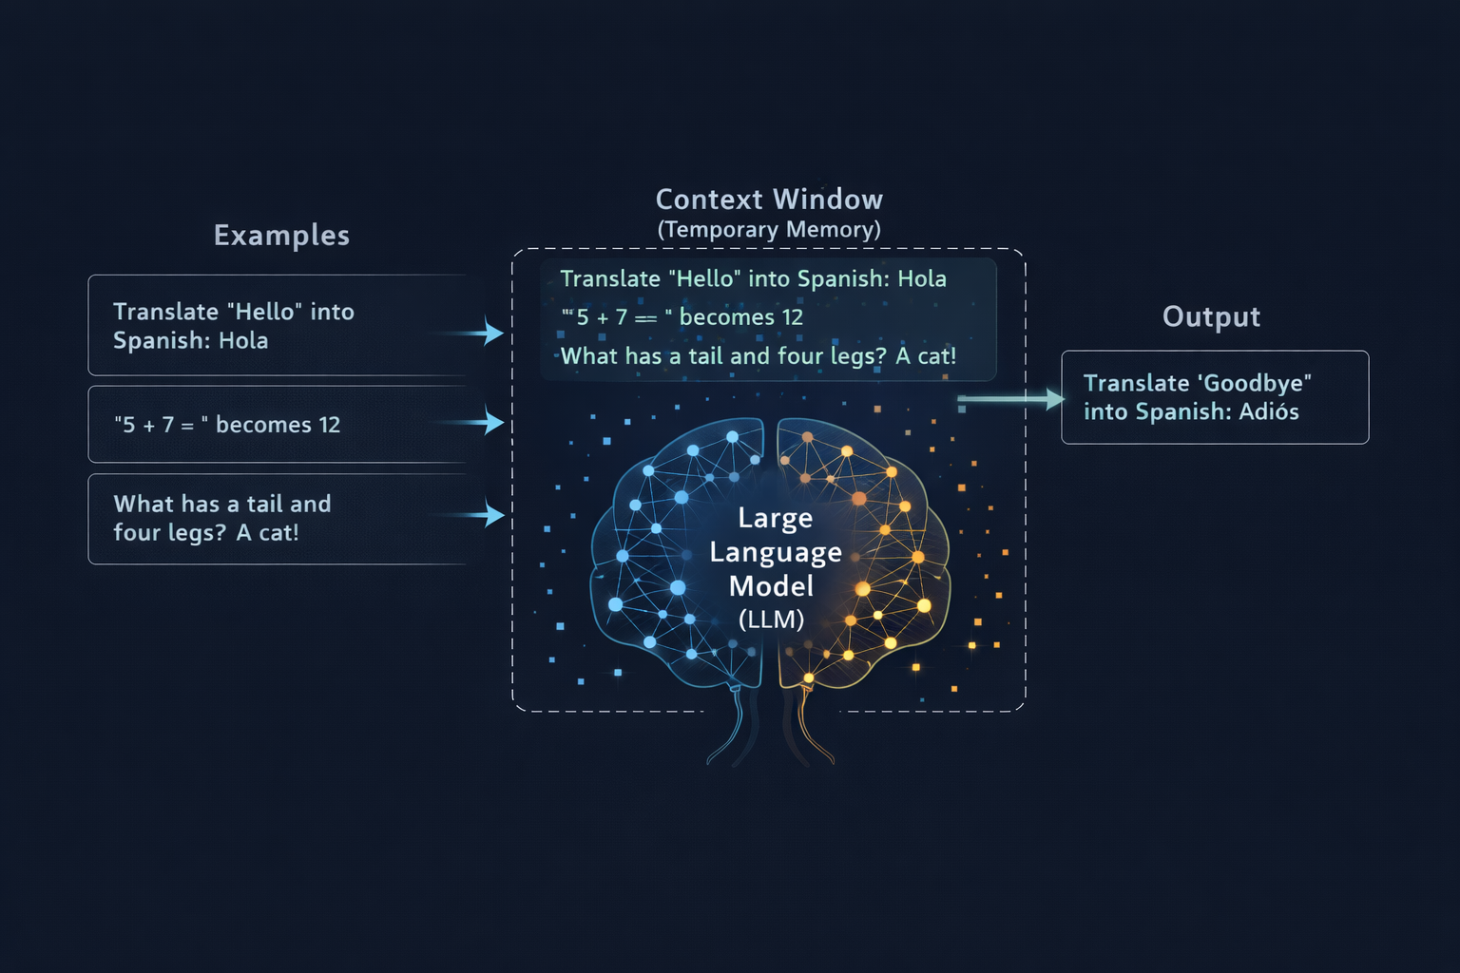
M08
Chapter 8.1 Introduction to Prompt Engineering: Why It Matters
Prompting as a Probabilistic Control Mechanism
Every prompt reconfigures the model’s internal state by emphasizing specific meanings, roles, and objectives. Effective prompts reduce randomness and increase task precision.
LLMs predict the next token probabilistically
Prompts act as soft constraints on attention
Specificity reduces generic or vague responses
Role, audience, and intent strongly influence outputs

Slide 8
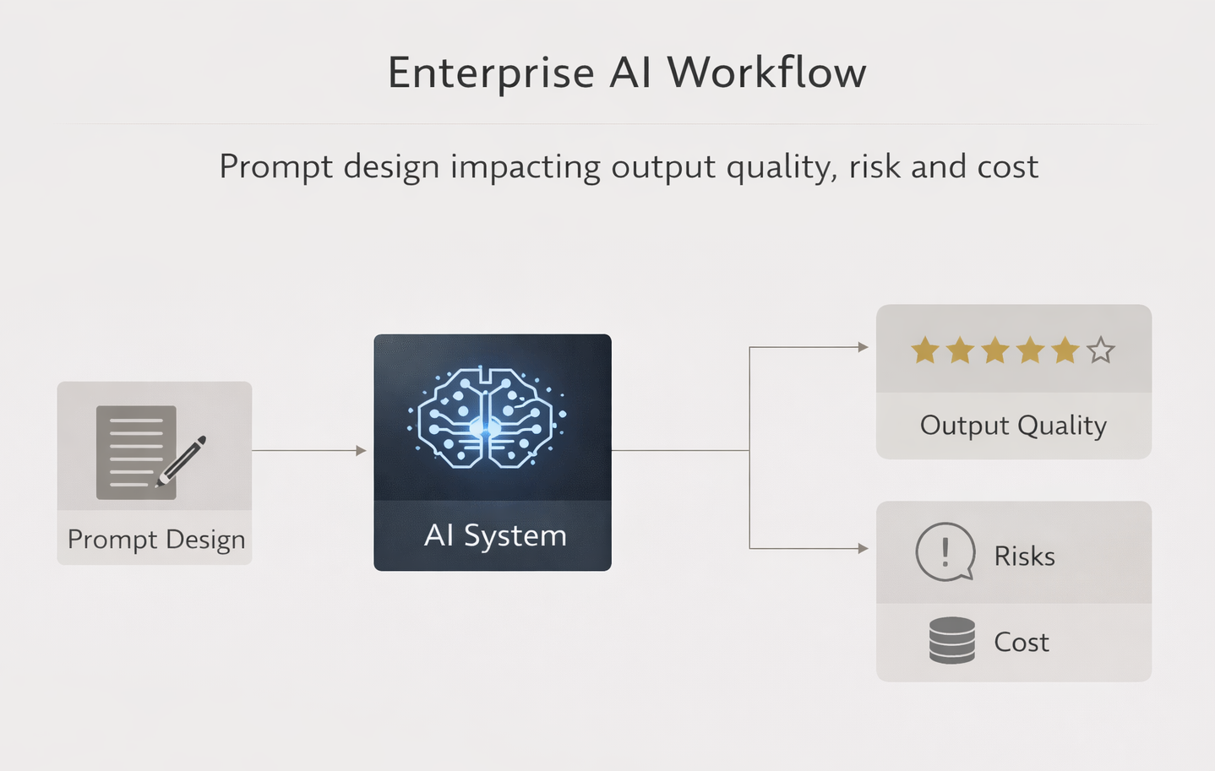
M08
Chapter 8.1 Introduction to Prompt Engineering: Why It Matters
Why Prompt Engineering Matters
Reliable AI systems require structured prompts, not ad-hoc instructions. Professional prompts are designed as modular data objects.
Instruction: the explicit task
Context: background knowledge or documents
Input data: variable user content
Output constraints: format, tone, structure

Slide 9
THEORY
Training Program 01
8.1 Introduction to Prompt Engineering: Why It Matters
8.2 In-Context Learning: Zero-Shot and Few-Shot
8.3 Chain-of-Thought: Eliciting Reasoning and Planning
8.4 Structured Prompting: RISEN and CARE Frameworks
8.5 Summary and Advanced Prompt Strategies

Slide 10
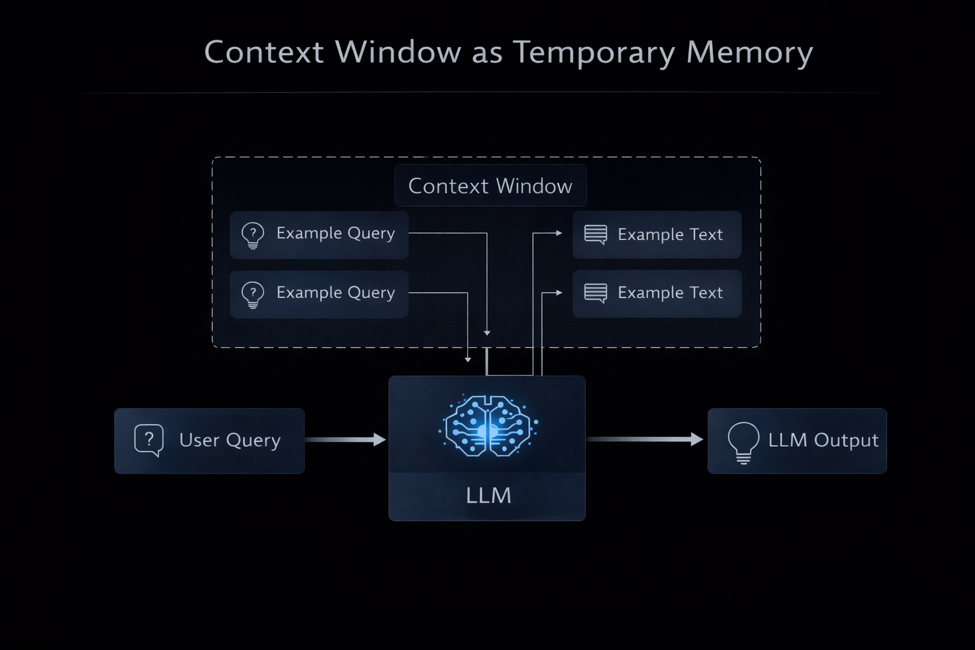
M08
Chapter 8.2 In-Context Learning: Zero-Shot and Few-Shot
What Is In-Context Learning (ICL)?
In-Context Learning allows an LLM to perform new tasks purely from information provided inside the prompt, without updating its weights.
Learning happens inside the context window.
No gradient updates or retraining involved.
Behavior is guided by prompt structure.
Knowledge is temporary and session-bound.

Slide 11
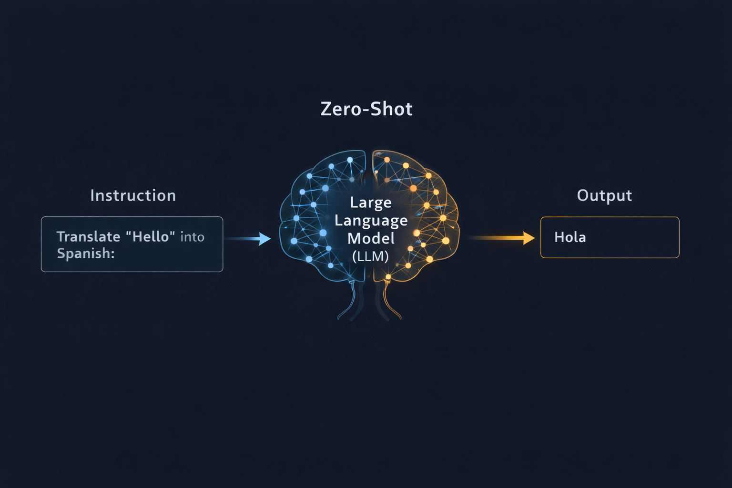
M08
Chapter 8.2 In-Context Learning: Zero-Shot and Few-Shot
Zero-Shot Learning
Zero-shot prompting asks the model to solve a task without seeing any examples, relying entirely on pre-training knowledge.
No demonstrations provided
Fast and low token cost
High flexibility but lower reliability
Often inconsistent formatting in complex tasks

Slide 12
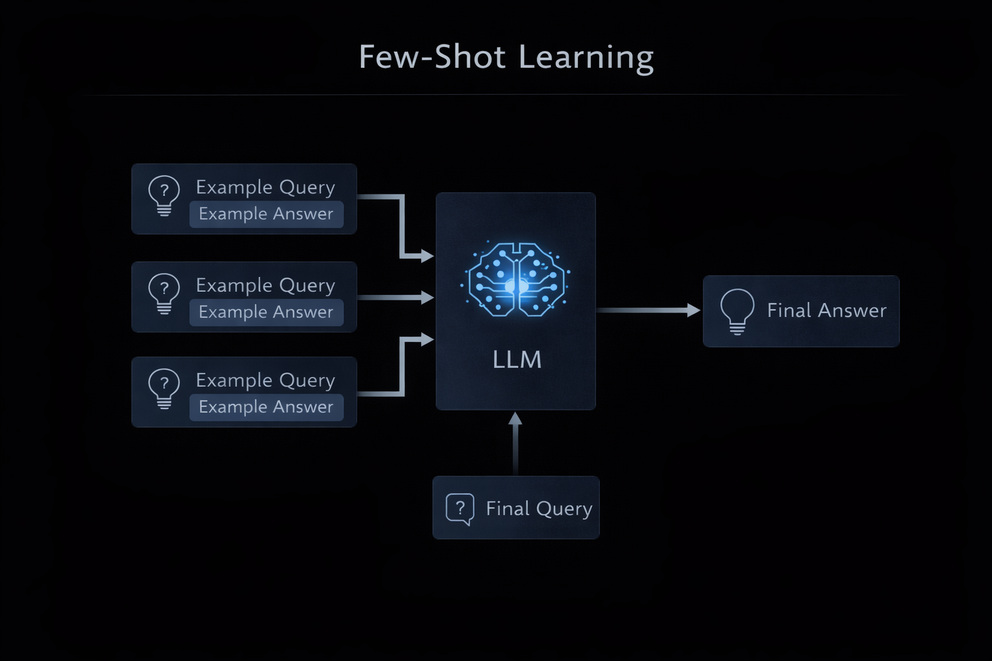
M08
Chapter 8.2 In-Context Learning: Zero-Shot and Few-Shot
Few-Shot Learning
Few-shot learning improves reliability by providing examples that demonstrate the desired input-output behavior.
Uses 3–10 example pairs.
Examples act as behavioral blueprints.
Strongly improves format and accuracy.
Increases token usage and latency.

Slide 13
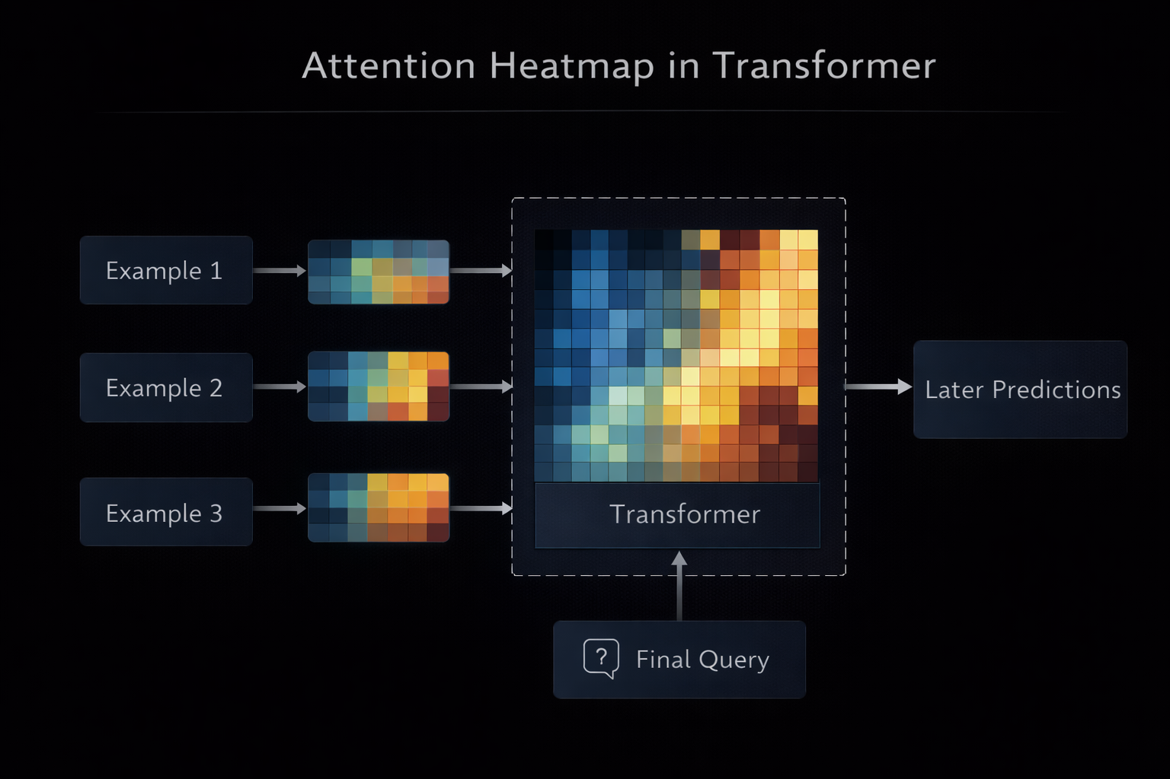
M08
Chapter 8.2 In-Context Learning: Zero-Shot and Few-Shot
Why Few-Shot Works?
Few-shot examples shift the model’s internal attention toward a specific task distribution, increasing output probability for correct patterns.
Primes attention and latent representations.
Reduces ambiguity in task interpretation.
Anchors tone, structure, and labels.
Works best with high-quality examples.

Slide 14
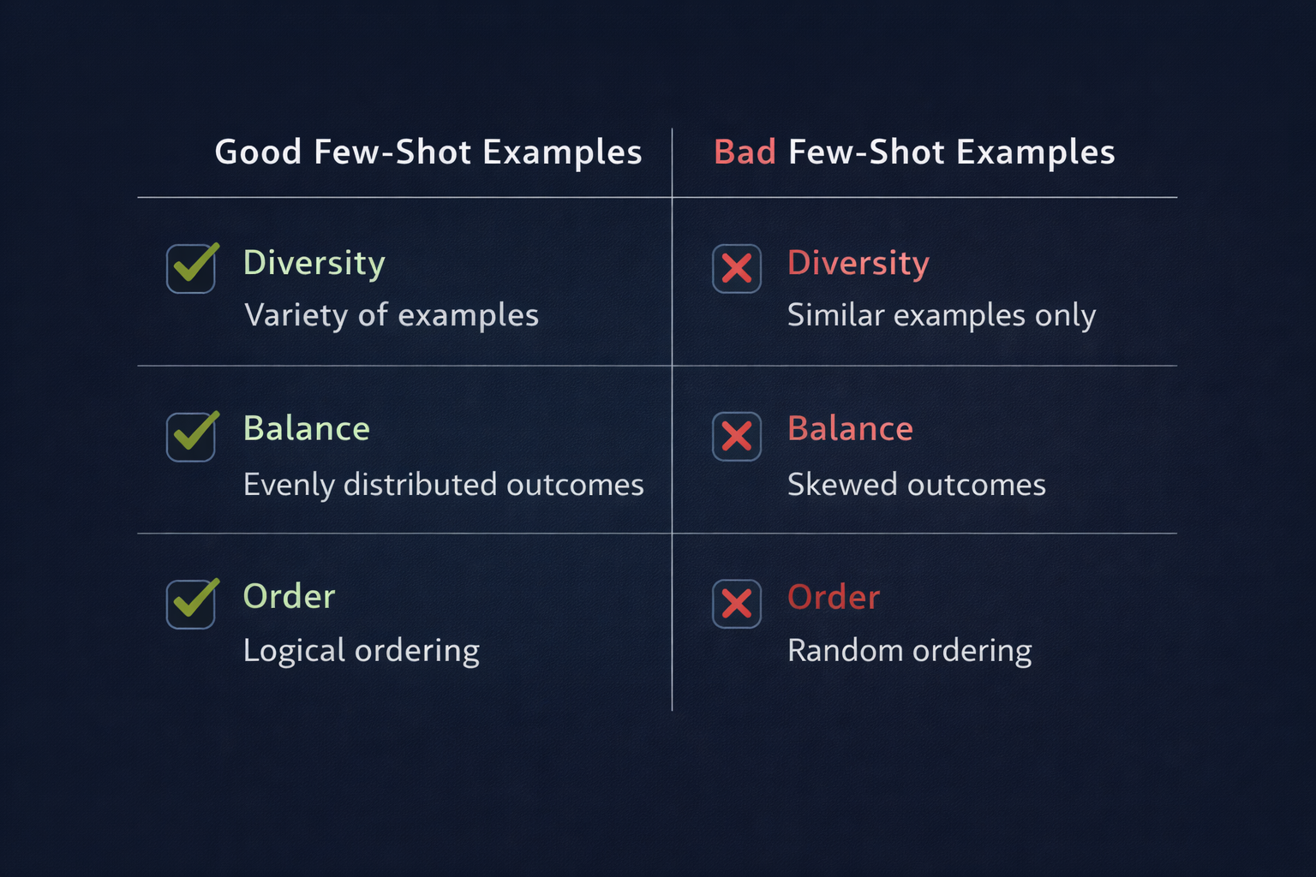
M08
Chapter 8.2 In-Context Learning: Zero-Shot and Few-Shot
Best Practices for In-Context Exam
Poor example selection can bias or degrade performance. Example quality matters more than quantity.
Use diverse and representative examples.
Balance labels in classification tasks.
Avoid repetitive patterns.
Order matters due to recency bias.

Slide 15
M08
Chapter 8.2 In-Context Learning: Zero-Shot and Few-Shot
Best Practices for In-Context Exam
Poor example selection can bias or degrade performance. Example quality matters more than quantity.
Use diverse and representative examples.
Balance labels in classification tasks.
Avoid repetitive patterns.
Order matters due to recency bias.

Slide 16
THEORY
Training Program 01
8.1 Introduction to Prompt Engineering: Why It Matters
8.2 In-Context Learning: Zero-Shot and Few-Shot
8.3 Chain-of-Thought: Eliciting Reasoning and Planning
8.4 Structured Prompting: RISEN and CARE Frameworks
8.5 Summary and Advanced Prompt Strategies

Slide 17
M08
Chapter 8.3 Chain-of-Thought: Eliciting Reasoning and Planning
Why Chain-of-Thought Works?
Standard prompting often fails on complex reasoning because models jump directly to answers. Chain-of-Thought prompting forces the model to externalize intermediate reasoning steps, improving accuracy.
Encourages step-by-step reasoning.
Reduces logical and arithmetic errors.
Activates latent reasoning capabilities.
Especially effective for math and logic tasks.

Slide 18
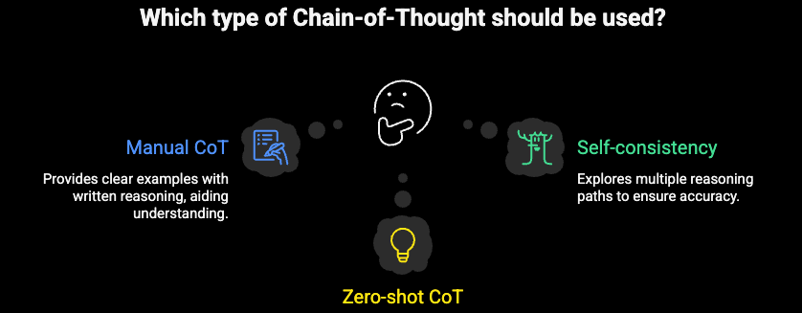
M08
Chapter 8.3 Chain-of-Thought: Eliciting Reasoning and Planning
Types of Chain of Thought
Chain-of-Thought can be manually demonstrated, automatically triggered, or expanded into branching reasoning structures.
Manual CoT: examples with written reasoning.
Zero-shot CoT: ‘Let’s think step by step’.
Self-consistency: multiple reasoning paths.
Majority vote filters incorrect logic.

Slide 19
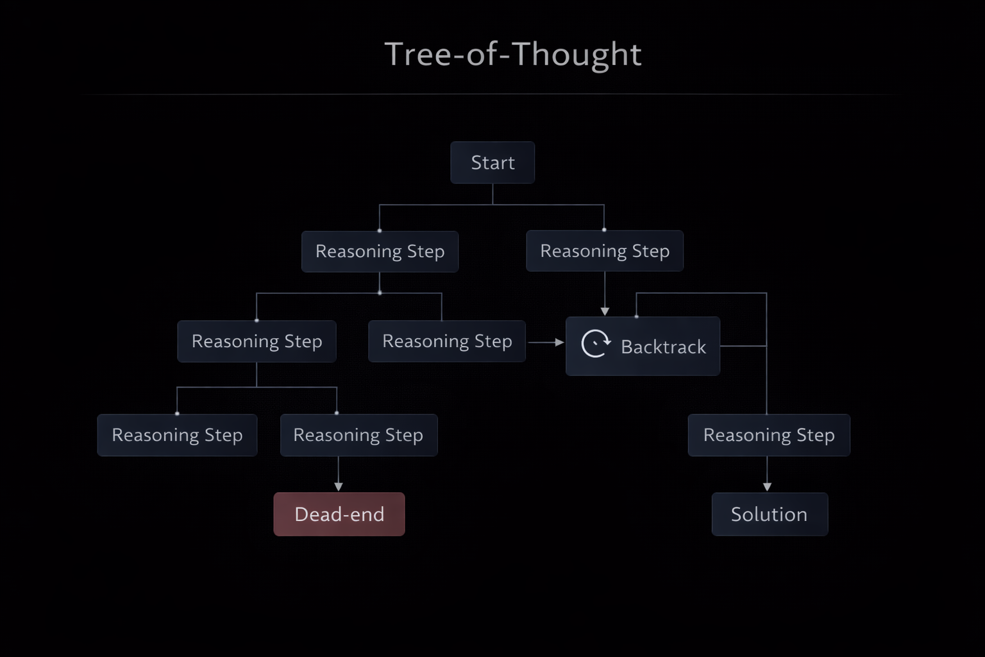
M08
Chapter 8.3 Chain-of-Thought: Eliciting Reasoning and Planning
Advanced Reasoning: Tree-of-Thought
Tree-of-Thought extends CoT by exploring multiple reasoning branches, enabling backtracking and deeper planning.
Branching instead of linear reasoning.
Enables exploration and pruning.
Mimics human problem-solving.
Used for planning and strategy tasks.

Slide 20
THEORY
Training Program 01
8.1 Introduction to Prompt Engineering: Why It Matters
8.2 In-Context Learning: Zero-Shot and Few-Shot
8.3 Chain-of-Thought: Eliciting Reasoning and Planning
8.4 Structured Prompting: RISEN and CARE Frameworks
8.5 Summary and Advanced Prompt Strategies

Slide 21
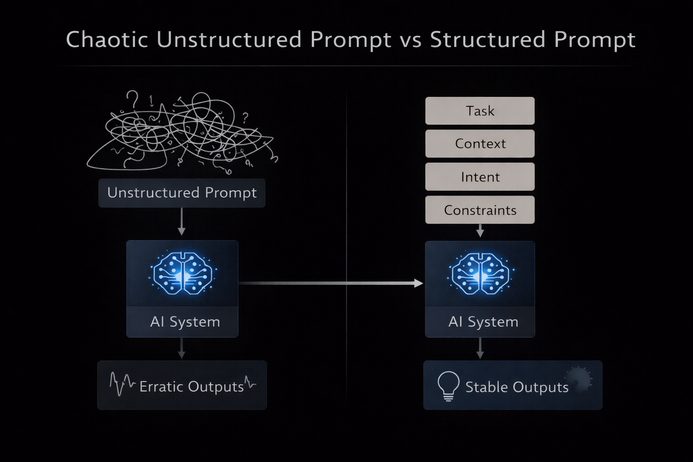
M08
Chapter 8.4 Structured Prompting: RISEN and CARE Frameworks
Why Structured Prompting Matters
Unstructured prompts lead to unstable, inconsistent outputs. Structured prompting frameworks introduce discipline, reproducibility, and reliability into LLM interactions.
Reduces ambiguity and off-topic responses.
Improves output consistency and format adherence.
Enables scalable, production-grade prompting.
Treats prompts as reusable system components.

Slide 22
M08
Chapter 8.4 Structured Prompting: RISEN and CARE Frameworks
RISEN Framework Explained
RISEN provides a comprehensive checklist to control model behavior, reasoning steps, and safety boundaries in professional prompts.
Role: defines model persona.
Instruction: clear primary task.
Steps: explicit reasoning process.
Examples: quality and format guidance.
Negative constraints: forbidden behaviors.

Slide 23
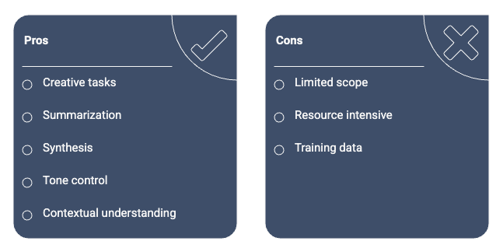
M08
Chapter 8.4 Structured Prompting: RISEN and CARE Frameworks
CARE Framework and Use Cases
CARE is optimized for creative, summarization, and synthesis tasks where tone, context, and output structure are critical.
Context: background or source material.
Action: what the model must do.
Response: output format and tone.
Examples: style anchoring.
Preferred for writing and analysis tasks.

Slide 24
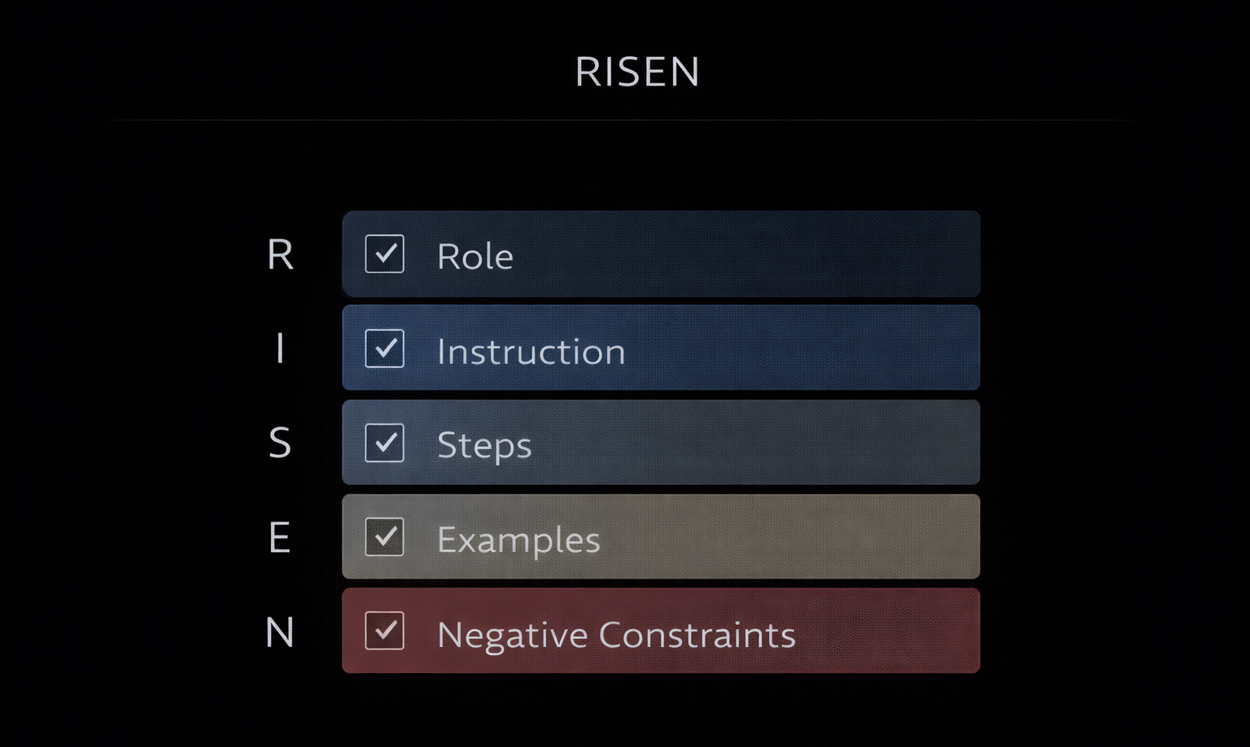
M08
Chapter 8.4 Structured Prompting: RISEN and CARE Frameworks
Production Prompt Architecture
In real systems, prompts are dynamic templates combining fixed system logic with runtime data injection.
System prompt remains constant.
User data injected dynamically.
Enables millions of safe interactions.
Facilitates testing and versioning.

Slide 25
THEORY
Training Program 01
8.1 Introduction to Prompt Engineering: Why It Matters
8.2 In-Context Learning: Zero-Shot and Few-Shot
8.3 Chain-of-Thought: Eliciting Reasoning and Planning
8.4 Structured Prompting: RISEN and CARE Frameworks
8.5 Summary and Advanced Prompt Strategies

Slide 26
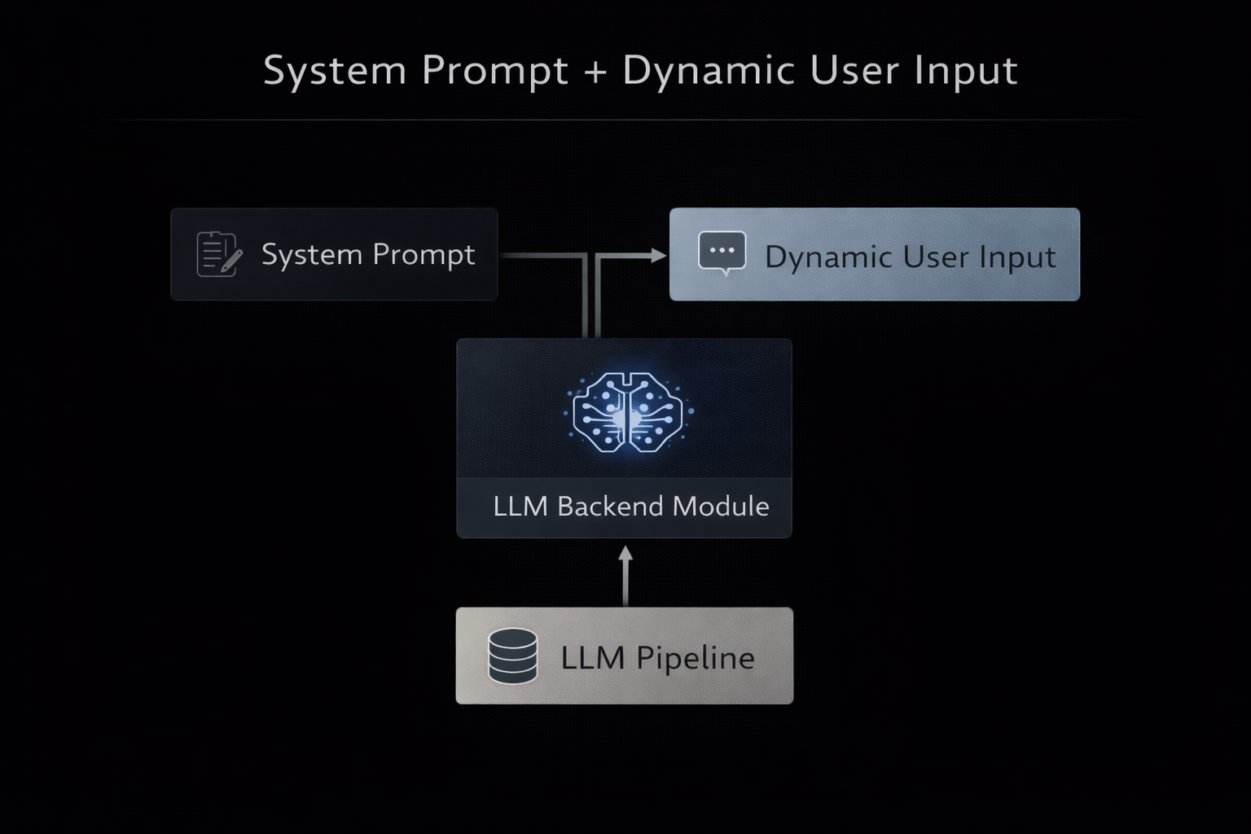
M08
Chapter 8.5 Summary and Advanced Prompt Strategies
Prompt Engineering Best Practices & Security
As LLMs move into production environments, prompt design must prioritize clarity, robustness, and security. Poorly designed prompts increase error rates, cost, and exposure to adversarial manipulation.
Be explicit and unambiguous in instructions.
Separate instruction, data, and constraints with delimiters.
Always enforce output formats (JSON, tables, schemas).
Treat prompts as executable system logic.
Defend against prompt injection attacks.

Slide 27
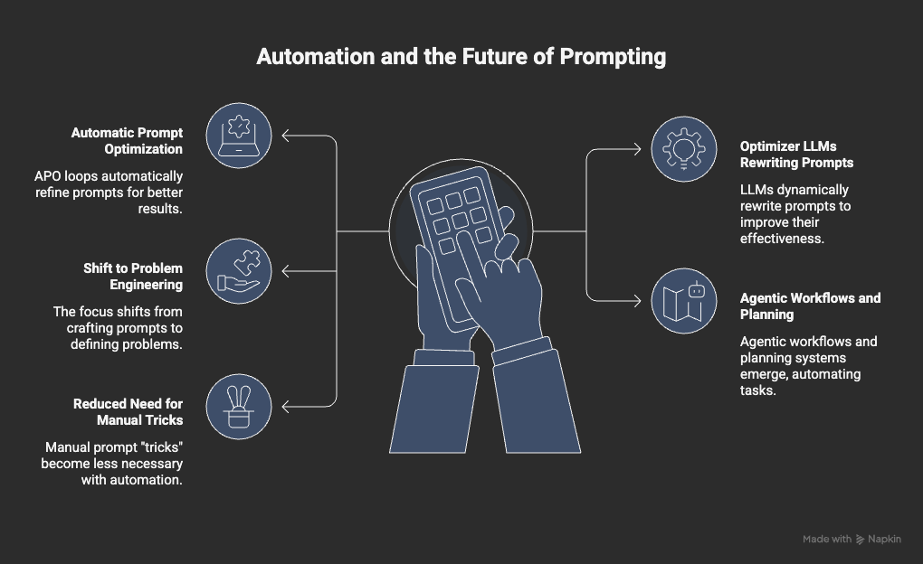
M08
Chapter 8.5 Summary and Advanced Prompt Strategies
Automation and the Future
of Prompting
The field is evolving from handcrafted prompts toward automated optimization and agentic systems where prompts become high-level intent specifications.
Automatic Prompt Optimization (APO) loops.
Optimizer LLMs rewriting prompts dynamically.
Shift from prompt engineering to problem engineering.
Emergence of agentic workflows and planning systems.
Reduced need for manual prompt “tricks”.

Slide 28
M08
Key References & Further Reading
Brown et al. (2020) — Language Models are Few-Shot Learners.
Reynolds & McDonell (2021) — Prompt Programming for Large Language Models.
Liu et al. (2021) — Pre-train, Prompt, and Predict: A Survey of Prompting Methods in NLP.
Wei et al. (2022) — Chain-of-Thought Prompting Elicits Reasoning in Large Language Models.
Wang et al. (2022) — Self-Consistency Improves Chain of Thought Reasoning.
Yao et al. (2023) — Tree of Thoughts: Deliberate Problem Solving with Large Language Models.
Zhou et al. (2023) — Large Language Models Are Human-Level Prompt Engineers.
Greshake et al. (2023) — Compromising Real-World LLM Applications via Indirect Prompt Injection.
Yao et al. (2023) — A Survey on Prompt Engineering for Foundation Models.

